Slide 1
Software Requirements Analysis and Specification
Requirements

Slide 2
Background
Scale of problem is a key issue for SE
For small scale, understand and specifying requirements is easy
For large problem - very hard; probably the hardest, most problematic and error prone
Input : user needs in minds of people
Output : precise statement of what the future system will do
Requirements

Slide 3
Background..
Identifying and specifying req necessarily involves people interaction
Cannot be automated
Requirement (IEEE)= A condition or capability that must be possessed by a system
Req. phase ends with a software requirements specification (SRS) document
SRS specifies what the proposed system should do
Requirements

Slide 4
Background..
Requirements understanding is hard
  Visualizing a future system is difficult
  Capability of the future system not clear, hence needs not clear
  Requirements change with time
  …
Essential to do a proper analysis and specification of requirements
Requirements

Slide 5
Need for SRS
SRS establishes basis of agreement between the user and the supplier.
  Users needs have to be satisfied, but user may not understand software
  Developers will develop the system, but may not know about problem domain
  SRS is the medium to bridge the commn. gap and specify user needs in a manner both can understand
Requirements

Slide 6
Need for SRS…
Helps user understand his needs.
  users do not always know their needs
  must analyze and understand the potential
  the goal is not just to automate a manual system, but also to add value through IT
  The req process helps clarify needs
SRS provides a reference for validation of the final product
  Clear understanding about what is expected.
  Validation - “ SW satisfies the SRS “
Requirements

Slide 7
Need for SRS…
High quality SRS essential for high Quality SW
  Requirement errors get manifested in final sw
  to satisfy the quality objective, must begin with high quality SRS
  Requirements defects are not few
    25% of all defects in average case
    54% of all defects found after Unit Testing
Requirements

Slide 8
Need for SRS…
Good SRS reduces the development cost
  SRS errors are expensive to fix later
  Req. changes can cost a lot
  Good SRS can minimize changes and errors
  Substantial savings; extra effort spent during req. saves multiple times that effort
An Example
  Cost of fixing errors in req. , design , coding , acceptance testing and operation are 2 , 5 , 15 , 50 , 150 person-months
Requirements

Slide 9
Need for SRS…
Example …
  After req. phase 65% req errs detected in design , 2% in coding, 30% in Acceptance testing, 3% during operation
  If 50 requirement errors are not removed in the req. phase, the total cost
  32.5 *5 + 1*15 + 15*50 + 1.5*150 = 1152 hrs
  If 100 person-hours invested additionally in req to catch these 50 defects , then development cost could be reduced by 1152 person-hours.
  Net reduction in cost is 1052 person-hours
Requirements

Slide 10
Requirements Process
Sequence of steps that need to be performed to convert user needs into SRS
Process has to elicit needs and requirements and clearly specifies it
Basic activities
  problem or requirement analysis
  requirement specification
  validation
Analysis involves elicitation and is the hardest
Requirements

Slide 11
Requirements Process..
needs
Analysis
Specification
Validation
Requirements

Slide 12
Requirement process..
Process is not linear, it is iterative and parallel
Overlap between phases - some parts may be analyzed and specified
Specification itself may help analysis
Validation can show gaps that can lead to further analysis and spec
Requirements

Slide 13
Requirements Process…
Focus of analysis is on understanding the desired systems and it’s requirements
Divide and conquer is the basic strategy
  decompose into small parts, understand each part and relation between parts
Large volumes of information is generated
  organizing them is a key
Techniques like data flow diagrams, object diagrams etc. used in the analysis
Requirements

Slide 14
Requirements Process..
Transition from analysis to specs is hard
  in specs, external behavior specified
  during analysis, structure and domain are understood
  analysis helps in specification, but the transition is not final
  methods of analysis are similar to that of design, but objective and scope different
  analysis deals with the problem domain, whereas design deals with solution domain
Requirements

Slide 15
Problem Analysis
Aim: to gain an understanding of the needs, requirements, and constraints on the software
Analysis involves
  interviewing client and users
  reading manuals
  studying current systems
  helping client/users understand new possibilities
  Like becoming a consultant
Must understand the working of the organization , client and users
Requirements

Slide 16
Problem Analysis…
Some issues
  Obtaining the necessary information
  Brainstorming: interacting with clients to establish desired properties
  Information organization, as large amount of info. gets collected
  Ensuring completeness
  Ensuring consistency
  Avoiding internal design
Requirements

Slide 17
Problem Analysis…
Interpersonal issues are important
Communication skills are very important
Basic principle: problem partition
Partition w.r.t what?
  Object - OO analysis
  Function - structural analysis
  Events in the system – event partitioning
Projection - get different views
Requirements

Slide 18
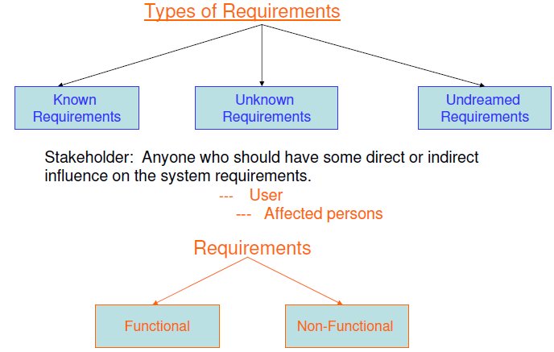
Types of requirements
Requirements

Slide 19
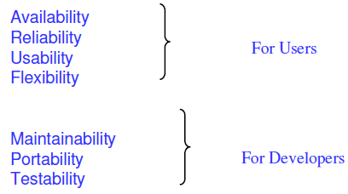
Types of requirements
Functional requirements describe what the software has to do. They are often called product features.
Non Functional requirements are mostly quality requirements. That stipulate how well the software does, what it has to do.
Requirements

Slide 20
Types of requirements
User and system requirements
  User requirement are written for the users and include functional and non functional requirement.
  System requirement are derived from user requirement.
  The user & system requirements are the parts of software requirement and specification (SRS) document.
Requirements

Slide 21
Characteristics of an SRS
What should be the characteristics of a good SRS? Some key ones are
  Complete
  Unambiguous
  Consistent
  Verifiable
  Ranked for importance and/or stability
Requirements

Slide 22
Characteristics…
Correctness
  Each requirement accurately represents some desired feature in the final system
Completeness
  All desired features/characteristics specified
  Hardest to satisfy
  Completeness and correctness strongly related
Unambiguous
  Each req has exactly one meaning
  Without this errors will creep in
  Important as natural languages often used
Requirements

Slide 23
Characteristics…
Verifiability
  There must exist a cost effective way of checking if sw satisfies requirements
Consistent
  two requirements don’t contradict each other
Ranked for importance/stability
  Needed for prioritizing in construction
  To reduce risks due to changing requirements
Requirements

Slide 24
Components of an SRS
What should an SRS contain ?
  Clarifying this will help ensure completeness
An SRS must specify requirements on
  Functionality
  Performance
  Design constraints
  External interfaces
Requirements

Slide 25
Functional Requirements
Heart of the SRS document; this forms the bulk of the specs
Specifies all the functionality that the system should support
Outputs for the given inputs and the relationship between them
All operations the system is to do
Must specify behavior for invalid inputs too
Requirements

Slide 26
Performance Requirements
All the performance constraints on the software system
Generally on response time , throughput etc => dynamic
Capacity requirements => static
Must be in measurable terms (verifiability)
  Eg resp time should be xx 90% of the time
Requirements

Slide 27
Design Constraints
Factors in the client environment that restrict the choices
Some such restrictions
  Standard compliance and compatibility with other systems
  Hardware Limitations
  Reliability, fault tolerance, backup req.
  Security
Requirements

Slide 28
External Interface
All interactions of the software with people, hardware, and sw
User interface most important
General requirements of “friendliness” should be avoided
These should also be verifiable
Requirements

Slide 29
Specification Language
Language should support desired char of the SRS
Formal languages are precise and unambiguous but hard
Natural languages mostly used, with some structure for the document
Formal languages used for special features or in highly critical systems
Requirements

Slide 30
Structure of an SRS
Introduction
  Purpose , the basic objective of the system
  Scope of what the system is to do , not to do
  Overview
Overall description
  Product perspective
  Product functions
  User characteristics
  Assumptions
  Constraints
Requirements

Slide 31
Structure of an SRS…
Specific requirements
  External interfaces
  Functional requirements
  Performance requirements
  Design constraints
Acceptable criteria
  desirable to specify this up front.
This standardization of the SRS was done by IEEE.
Requirements

Slide 32
Use Case approach for Software Requirement specification
Requirements

Slide 33
Use Cases Approach for Functional Requirements
Traditional approach for fn specs – specify each function
Use cases is a newer technique for specifying behavior (functionality)
I.e. focuses on functional specs only
Though primarily for specification, can be used in analysis and elicitation
Can be used to specify business or org behavior also, though we will focus on sw
Well suited for interactive systems
Requirements

Slide 34
Use Cases Basics
A use case captures a contract between a user and system about behavior
Basically a textual form; diagrams are mostly to support
Also useful in requirements elicitation as users like and understand the story telling form and react to it easily
Requirements

Slide 35
Basics..
Actor: a person or a system that interacts with the proposed system to achieve a goal
  Eg. User of an ATM (goal: get money); data entry operator; (goal: Perform transaction)
Actor is a logical entity, so receiver and sender actors are different (even if the same person)
Actors can be people or systems
Primary actor: The main actor who initiates a UC
  UC is to satisfy his goals
  The actual execution may be done by a system or another person on behalf of the Primary actor
Requirements

Slide 36
Basics..
Scenario: a set of actions performed to achieve a goal under some conditions
  Actions specified as a sequence of steps
  A step is a logically complete action performed either by the actor or the system
Main success scenario – when things go normally and the goal is achieved
Alternate scenarios: When things go wrong and goals cannot be achieved
Requirements

Slide 37
Basics..
A UC is a collection of many such scenarios
A scenario may employ other use cases in a step
I.e. a sub-goal of a UC goal may be performed by another UC
I.e. UCs can be organized hierarchically
Requirements

Slide 38
Example
Use Case 1: Buy stocks
Primary Actor: Purchaser
Goals of Stakeholders:
Purchaser: wants to buy stocks
Company: wants full transaction info
Precondition: User already has an account
Requirements

Slide 39
Example …
Main Success Scenario
  User selects to buy stocks
  System gets name of exchange from user for trading
  Establishes connection
  User browses and buys stocks
  System intercepts responses from the exchange site and updates user portfolio
  System shows user new portfolio
Requirements

Slide 40
Example…
Alternatives
  2a: System gives err msg, asks for new suggestion exchange, gives option to cancel
  3a: Web failure. 1-Sys reports failure to user, backs up to previous step. 2-User exits or tries again
  4a: Stocks not displayed in the exchange website
  4b: web site does not ack purchase
  5a: web site does not return needed info
Requirements

Slide 41
Example 2
Use Case 2: Buy a product
Primary actor: buyer/customer
Goal: purchase some product
Precondition: Customer is already logged in
Requirements

Slide 42
Example 2…
Main Scenario
  Customer browses and selects items
  Customer goes to checkout
  Customer fills shipping options
  System presents full pricing info
  Customer fills credit card info
  System authorizes purchase
  System confirms sale
  System sends confirming email
Requirements

Slide 43
Example 2…
Alternatives
  6a: Credit card authorization fails
    Allows customer to re-enter info
  3a: Regular customer
    System displays last 4 digits of credit card no
    Asks customer to OK it or change it
    Moves to step 6
Requirements

Slide 44
Example 3
Design Use Case for Bus Reservation System
Requirements

Slide 45
Example – An auction site
Use Case1: Put an item for auction
Primary Actor: Seller
Precondition: Seller has logged in
Main Success Scenario:
  Seller posts an item (its category, description, picture, etc.) for auction
  System shows past prices of similar items to seller
  System specifies the starting bid price and a date when auction will close
  System accepts the item and posts it
Exception Scenarios:
  -- 2 a) There are no past items of this category
  * System tells the seller this situation
Requirements

Slide 46
Example – auction site..
Use Case2: Make a bid
Primary Actor: Buyer
Precondition: The buyer has logged in
Main Success Scenario:
  Buyer searches or browses and selects some item
  System shows the rating of the seller, the starting bid, the current bids, and the highest bid; asks buyer to make a bid
  Buyer specifies bid price, max bid price, and increment
  Systems accepts the bid; Blocks funds in bidders account
  System updates the bid price of other bidders where needed, and updates the records for the item
Requirements

Slide 47
Exception Scenarios:
  -- 3 a) The bid price is lower than the current highest
  * System informs the bidder and asks to rebid
  -- 4 a) The bidder does not have enough funds in his account
  * System cancels the bid, asks the user to get more funds
Requirements

Slide 48
Example –auction site..
Use Case3: Complete auction of an item
Primary Actor: Auction System
Precondition: The last date for bidding has been reached
Main Success Scenario:
  Select highest bidder; send email to selected bidder and seller informing final bid price; send email to other bidders also
  Debit bidder’s account and credit seller’s account
  Transfer from seller’s account commission amount to organization’s account
  Unblock other bidders funds
  Remove item from the site; update records
Exception Scenarios: None
Requirements

Slide 49
Example – summary-level Use Case
Use Case 0 : Auction an item
Primary Actor: Auction system
Scope: Auction conducting organization
Precondition: None
Main Success Scenario:
  Seller performs put an item for auction
  Various bidders make a bid
  On final date perform Complete the auction of the item
  Get feed back from seller; get feedback from buyer; update records
Requirements

Slide 50
Requirements with Use Cases
UCs specify functional requirements
Other req identified separately
A complete SRS will contain the use cases plus the other requirements
Note – for system requirements it is important to identify UCs for which the system itself may be the actor
Requirements

Slide 51
Developing Use Cases
UCs form a good medium for brainstorming and discussions
Hence can be used in elicitation and problem analysis also
UCs can be developed in a stepwise refinement manner
  Many levels possible, but four naturally emerge
Requirements

Slide 52
Developing…
Step 1: Identify actors and goals
  Prepare an actor-goal list
  Provide a brief overview of the UC
  This defines the scope of the system
  Completeness can also be evaluated
Step 2: Specify main Success Scenarios
  For each UC, expand main scenario
  This will provide the normal behavior of the system
  Can be reviewed to ensure that interests of all stakeholders and actors is met
Requirements

Slide 53
Developing…
Step 3: Identify failure conditions
  List possible failure conditions for UCs
  For each step, identify how it may fail
  This step uncovers special situations
Step 4: Specify failure handling
  Perhaps the hardest part
  Specify system behavior for the failure conditions
  New business rules and actors may emerge
Requirements

Slide 54
Other Approaches to Analysis
Requirements

Slide 55
Data Flow Modeling
Widely used; focuses on functions performed in the system
Views a system as a network of data transforms through which the data flows
Uses data flow diagrams (DFDs) and functional decomposition in modeling
The SSAD methodology uses DFD to organize information, and guide analysis
Requirements

Slide 56
Data flow diagrams
A DFD shows flow of data through the system
  Views system as transforming inputs to outputs
  Transformation done through transforms
  DFD captures how transformation occurs from input to output as data moves through the transforms
  Not limited to software
Requirements

Slide 57
Data flow diagrams…
DFD
  Transforms represented by named circles/bubbles
  Bubbles connected by arrows on which named data travels
  A rectangle represents a source or sink and is originator/consumer of data (often outside the system)
Requirements

Slide 58
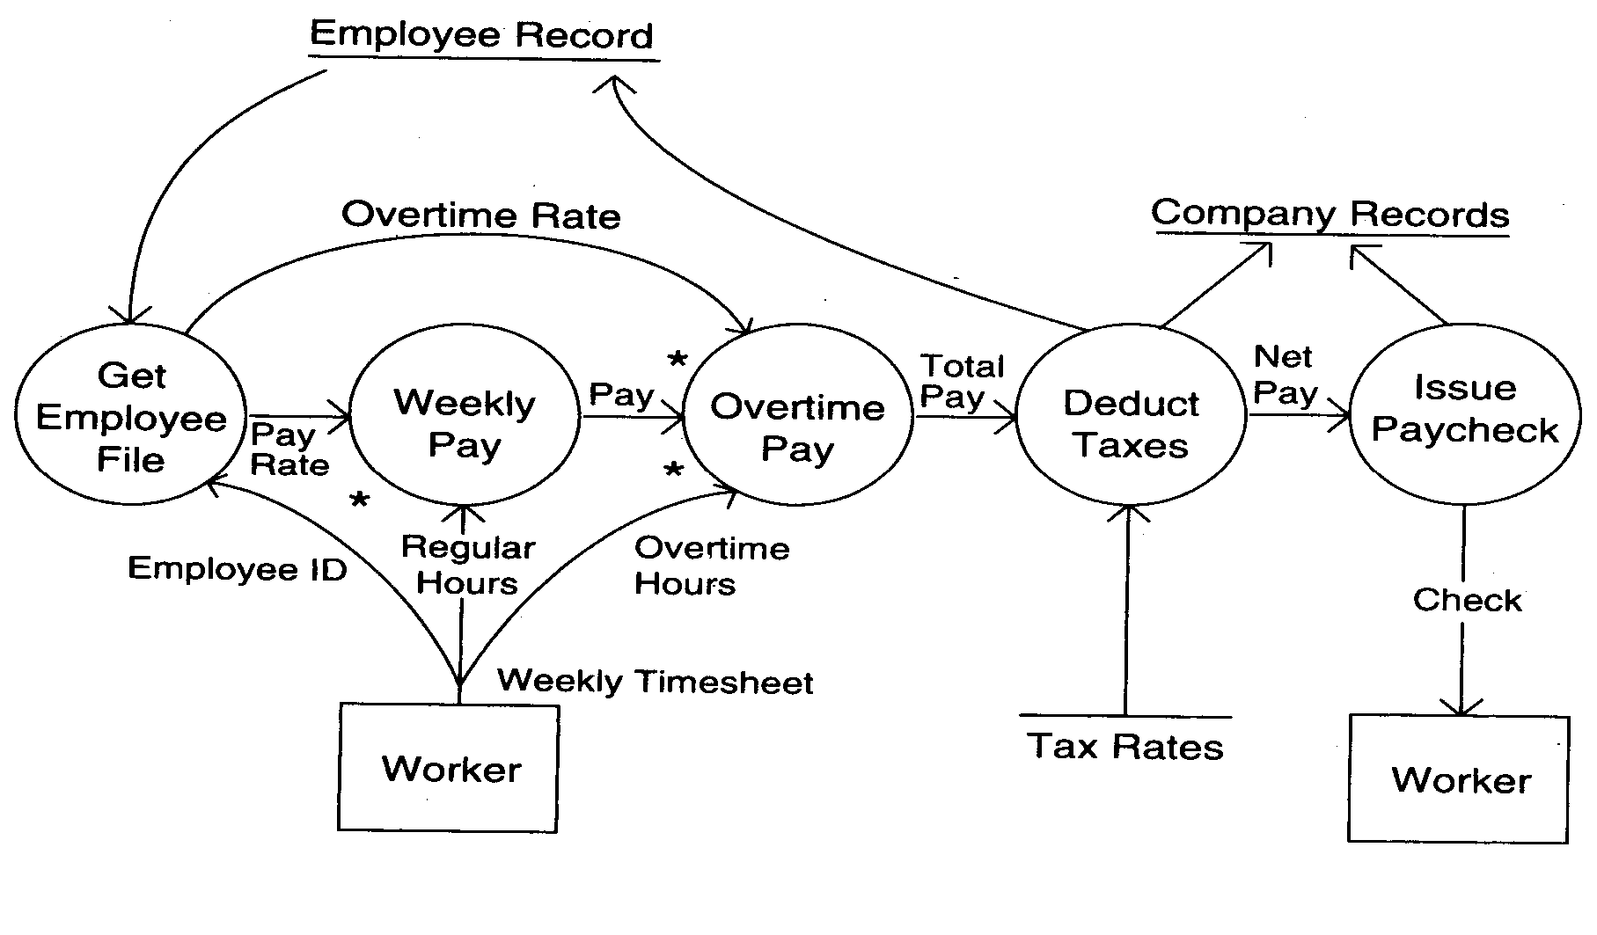
DFD Example
Requirements

Slide 59
DFD Conventions
External files shown as labeled straight lines
Need for multiple data flows by a process represented by * (means and)
OR relationship represented by +
All processes and arrows should be named
Processes should represent transforms, arrows should represent some data
Requirements

Slide 60
Data flow diagrams…
Focus on what transforms happen , how they are done is not important
Usually major inputs/outputs shown, minor are ignored in this modeling
No loops , conditional thinking , …
DFD is NOT a control chart, no algorithmic design/thinking
Sink/Source , external files
Requirements

Slide 61
Drawing a DFD
If get stuck , reverse direction
If control logic comes in , stop and restart
Label each arrows and bubbles
Make use of + & *
Try drawing alternate DFDs
Leveled DFDs :
DFD of a system may be very large
Can organize it hierarchically
Start with a top level DFD with a few bubbles
then draw DFD for each bubble
Preserve I/O when “ exploding”
Requirements

Slide 62
Drawing a DFD for a system
Identify inputs, outputs, sources, sinks for the system
Work your way consistently from inputs to outputs, and identify a few high-level transforms to capture full transformation
If get stuck, reverse direction
When high-level transforms defined, then refine each transform with more detailed transformations
Requirements

Slide 63
Drawing a DFD for a system..
Never show control logic; if thinking in terms of loops/decisions, stop & restart
Label each arrows and bubbles; carefully identify inputs and outputs of each transform
Make use of + & *
Try drawing alternate DFDs
Requirements

Slide 64
Leveled DFDs
DFD of a system may be very large
Can organize it hierarchically
Start with a top level DFD with a few bubbles
then draw DFD for each bubble
Preserve I/O when “ exploding” a bubble so consistency preserved
Makes drawing the leveled DFD a top-down refinement process, and allows modeling of large and complex systems
Requirements

Slide 65
Data Dictionary
In a DFD arrows are labeled with data items
Data dictionary defines data flows in a DFD
Shows structure of data; structure becomes more visible when exploding
Can use regular expressions to express the structure of data
Requirements

Slide 66
Data Dictionary Example
For the timesheet DFD
Weekly_timesheet – employee_name + id + [regular_hrs + overtime_hrs]*
Pay_rate = [hourly | daily | weekly] + dollar_amt
Employee_name = last + first + middle
Id = digit + digit + digit + digit
Requirements

Slide 67
DFD drawing – common errors
Unlabeled data flows
Missing data flows
Extraneous data flows
Consistency not maintained during refinement
Missing processes
Too detailed or too abstract
Contains some control information
Requirements

